Slide 1

A Tutorial on Explainable Pathology AI
Notes:
Outline:
Introduction to XAI, interpret ML. refer to Christoph’s book, and surveys.
XAI in medical domain, refer to the survey
Application in pathological detection, refer to my paper.
Implementation with MindSpore Explanation.
Evaluation method and criteria in this challenge.

Slide 2
Outline
Background
XAI Methods for Pathological Detection
Implementation and Evaluation

Slide 3
Background
01

Slide 4
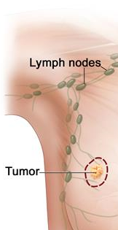

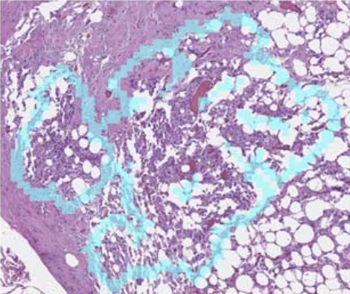
AI in Pathological Diagnosis
DL-based diagnostic models in CAD systems
Predict the diagnostic value given the acquired medical data of a subject
Example - breast cancer diagnosis
Neurological disorders, Alzheimer’s disease, etc
Clinical importance
Diagnostic accuracy
Review efficiency
Malignant
Benign
Normal
Sampling
Imaging and Digitalization
Diagnostic model
Diagnostic values
(Reference evidence)
 | Unassisted | Assisted
Accuracy | 83% | 91%
Review T. (s) | 117 | 61
Obviousness Score | 63.1 | 83.6
Impact of DL-assistance on Metastatic Breast Cancer Diagnosis
Notes:
Here is the background. Learning-based diagnostic models play a critical role in computer-aided diagnosis systems. Its major goal is to predict the diagnostic value or disease state given the acquired medical data of a subject. For example, to diagnose breast cancer metastasis, clinicians will sample the lymph node tissue from the subject and use the imaging and digitalization device to screen the tissue slice and obtain the histology images. ** At the core of this workflow is the diagnostic model for analyzing the pathology and predicting the diagnostic values, such as normal, benign,and malignant. The model may also provide other reference evidence, such as the localized tumor cells or other biomarkers for grading the disease.
The diagnostic models are clinically important in two aspects. First, it can increase the diagnostic accuracy in clinics. Second, it can improve the review efficiency for clinicians. (Click) According to a recent study investigating the impact of deep learning assistance on breast cancer detection, without deep learning assistance, pathologists take about two minutes to review a histology slide with an accuracy of 83%. With the assitance of deep learning models, the review time is reduced to about 1 minute and the diagnostic accuracy is improved to 91%, which means the pathologists can detect the breast cancer more accurately with less time. (Point) As qualified by the obviousness score, the pathologists also find it easier to finish the diagnosis task under the assistance of deep learning.
(it’s for micro-metastatic)
(1+3=4)
---- Todo: shorten the script for this slide, e.g., don’t say 17% missed.
To quantify the subjective difficulty of the classification task for each image, pathologists were requested to provide an “obviousness score” from 0 to 100 for each image based on how easily they were able to reach a final diagnosis. consider this value as a ranking, relative to the last 100 breast cancer lymph, 0 representing the most challenging, 100. ➔ the higher, the easier they subjective feel for finishing the diagnosis.
CAD is an essential task in medical image analysis.
This is an essential task for a computer-assisted diagnosis system.
One mainstream workflow to finalize the disease stage includes sampling the tissue, imaging and digitalizing to obtain the histology image,

Slide 5

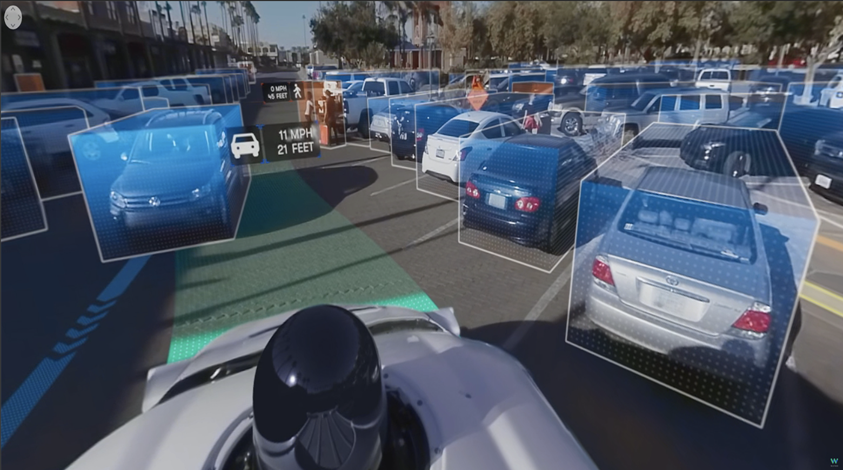
AI in Real-world Applications
Healthcare, MIC and CAI
Smart city
Auto-drive
Fintech (loan, credit, quant. trading)
….
Explainable and trustable AI are demanding.
https://www.huawei.com/minisite/building-an-intelligent-world-together/cn/
Notes:
Deep learning has empowered lots of real-world applications in many fields,
华为 深圳智慧城市
使用图片检测技术替代传统高强度高风险的人工现场巡视值守，提高了准确率，降低了危险

Slide 6
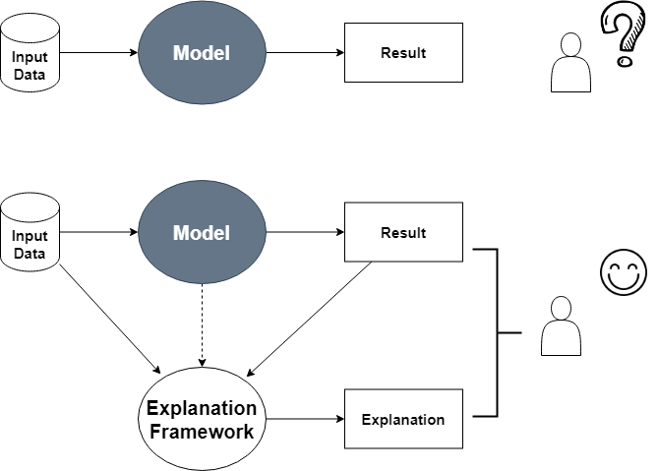
Blackbox models assisted with Explanation Tools
We get results, but we don’t know why.
Trust it or not?
We also get explanation! We now understand:
1. How does the trained model make predictions? (Global Interpretability)
2. Why did the model make a certain prediction for an instance? (Local Interpretability)
And finally, decide to trust it or not.
DL can be tricky, we need XAI.
Notes:
Global, like tree models, linear model surrogate. Give Feature importance. Rules.
In response, explainable artificial intelligence emerges, aiming to explain the predictions and behaviors of deep learning models.

Slide 7

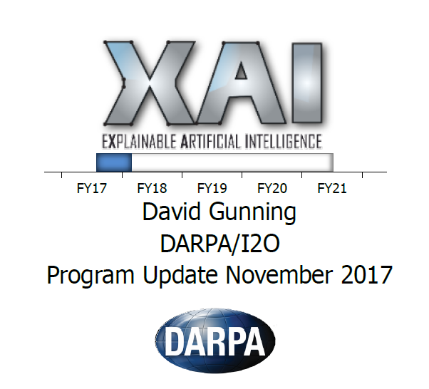

XAI Booming in Industry
[US] Defense Advanced Research Projects Agency(DARPA) initiates “XAI” project in 2017
[CHN] XAI included in “New Generation Artificial Intelligence Development Plan” issued by state council
[UK] XAI included in AI white paper issued by house of UK

Slide 8
XAI Progress in Academia
2017
2018
2019
2020
IJCAI
IEEE VIS
IEEE VIS
AAAI
CVPR
IJCAI 2017 Workshop on Explainable Artificial Intelligence (XAI)
1st Workshop on Visualization for AI Explainability
2nd Workshop on Visualization for AI Explainability
AAAI 2019 Tutorial On Explainable AI
cvpr 2-2- TUTORIAL
TUTORIAL ON INTERPRETABLE MACHINE LEARNING
NIPS
IJCAI/ECAI
IJCAI
CVPR
Interpretable ML Symposium
IJCAI/ECAI 2018 Workshop on Explainable Artificial Intelligence (XAI)
IJCAI 2019 WORKSHOP ON
EXPLAINABLE ARTIFICIAL INTELLIGENCE (XAI)
CVPR-19 Workshop on Explainable AI
FAT
ICML
ICAPS
ICCC
FAT 2020 tUTOrial
Explainable AI in Industry:Practical Challenges and Lessons Learned
2018 Workshop on Human Interpretability
in Machine Learning (WHI)
2nd ICAPS Workshop on
Explainable Planning (XAIP-2019)
2019 ICCV Workshop
on Interpreting and Explaining Visual
Artificial Intelligence Models
NIPS & GOOGLE BRAIN
HCI
KDD
Visualization for Machine Learning
Human-Centered Machine Learning
Perspectives Workshop
KDD
kdd 2019 Tutorial
Explainable AI in Industry
kdd 2020 Tutorial
Intelligible and Explainable Machine Learning-Best Practices

Slide 9
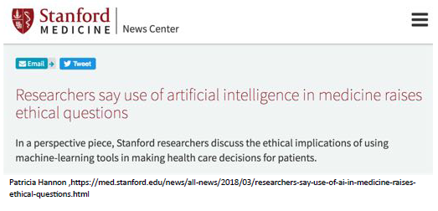

XAI Importance in Healthcare
The black-box nature of DL has restricted its clinical deployment.
Explainability leads to responsibility
Hospital, insurance and patients know how to share risk
Interpretability leads to trust
Doctors know when and how to rely on AI
Interpretability leads to user-friendliness
Clinical end-users without deep learning experience can understand model behaviors.

Slide 10
XAI Methods for Pathological Detection
02

Slide 11
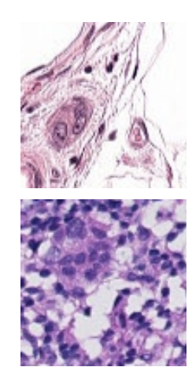
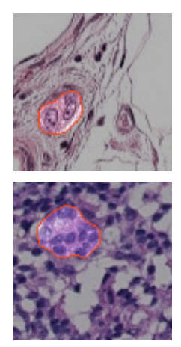
Using saliency map to interpret pathology diagnosis
Localize the evident regions supporting the diagnostic decision made by the DL model.
Cancerous
Pathology image
Localized Evidence
Evidence Localization for Pathology Images using Weakly Supervised Learning, MICCAI 2019

Slide 12
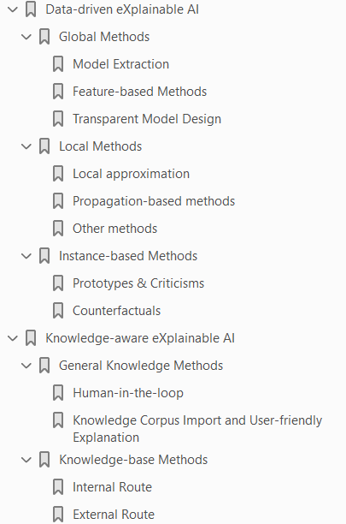
Overview of XAI Methods
Local explanation:
Local surrogate: LIME
Propagation & Gradients: Guided Backprop, Grad-CAM, Integrated Gradient, LRP, DeepLIFT
Perturbation: Occlusion, RISE
Game theory: SHAP, DeepSHAP
CF: DiCE, CVE
Model-inherent Attention
Li, X. H., Cao, C. C., Shi, Y., Bai, W., Gao, H., Qiu, L., ... & Chen, L. (2020). A survey of data-driven and knowledge-aware explainable ai. IEEE Transactions on Knowledge and Data Engineering.
Notes:
For more details, please refer to this survey and the related papers.

Slide 13
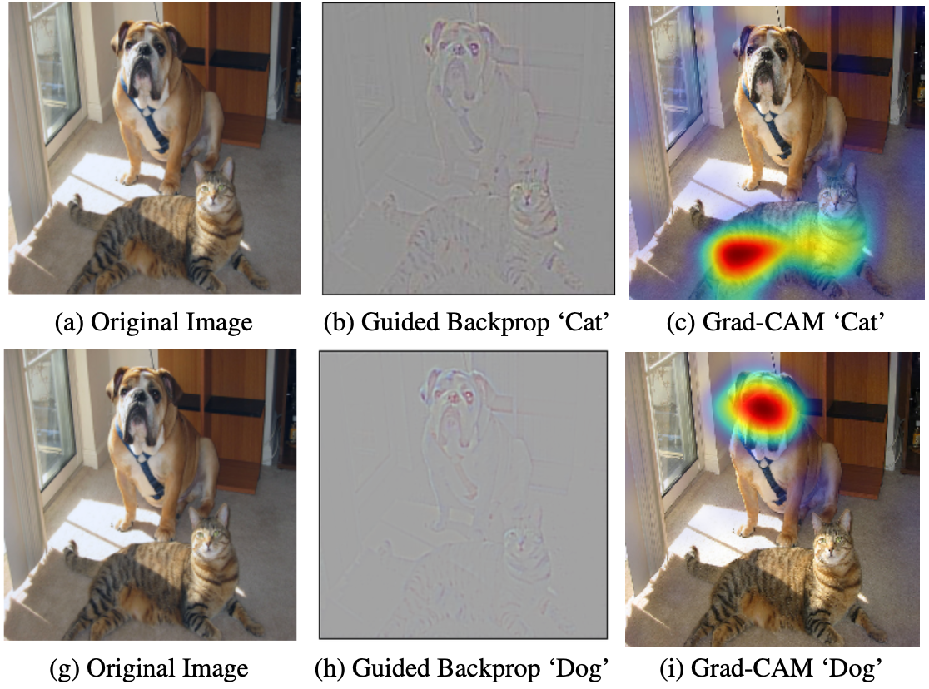
Local Methods for Interpreting CV Models
Saliency map – showing the important regions on an image that affect the model prediction.
Model dependent
Guided Backprop
Grad-CAM
Integrated gradient
Model agnostic
Occlusion
RISE
Grad-CAM - Visual Explanations from Deep Networks via Gradient-based Localization, Selvaraju, 2017

Slide 14
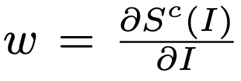
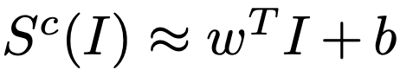
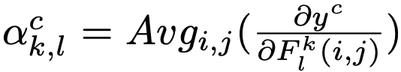
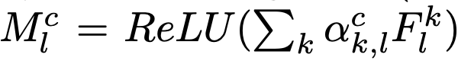
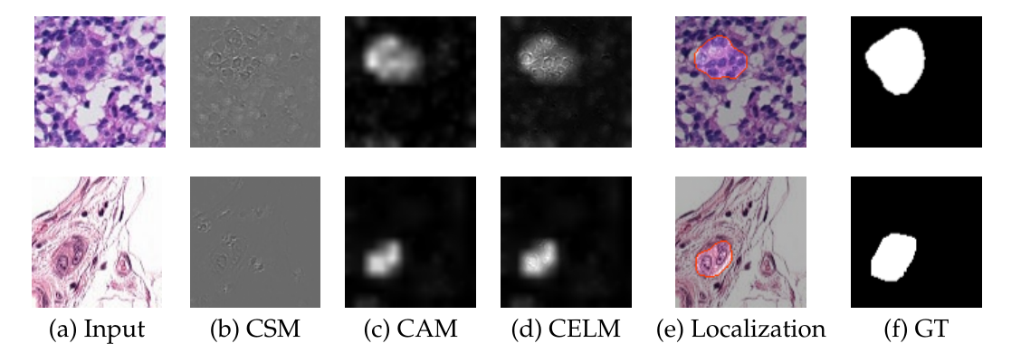
Derive saliency maps with Guided-Backprop and Grad-CAM
Guided-Backprop
Stop negative gradient flows and perform smoothing.
Grad-CAM
Evidence Localization for Pathology Images using Weakly Supervised Learning, MICCAI 2019

Slide 15
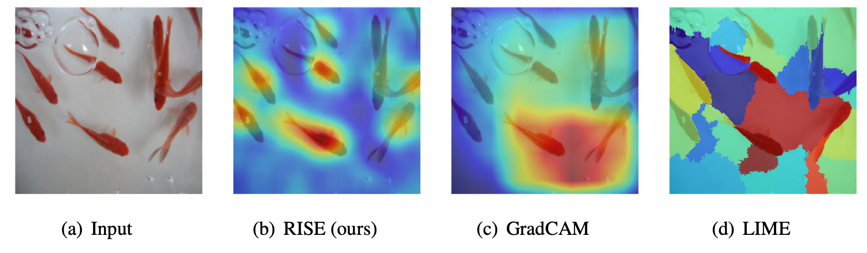
Local Methods for Interpreting CV Models
Saliency map – showing the important regions on an image that affect the model prediction.
Model dependent
Guided Backprop
Grad-CAM
Integrated gradient
Model agnostic
Occlusion
RISE
RISE: Randomized Input Sampling for Explanation of Black-box Models , Petsiuk , 2018

Slide 16
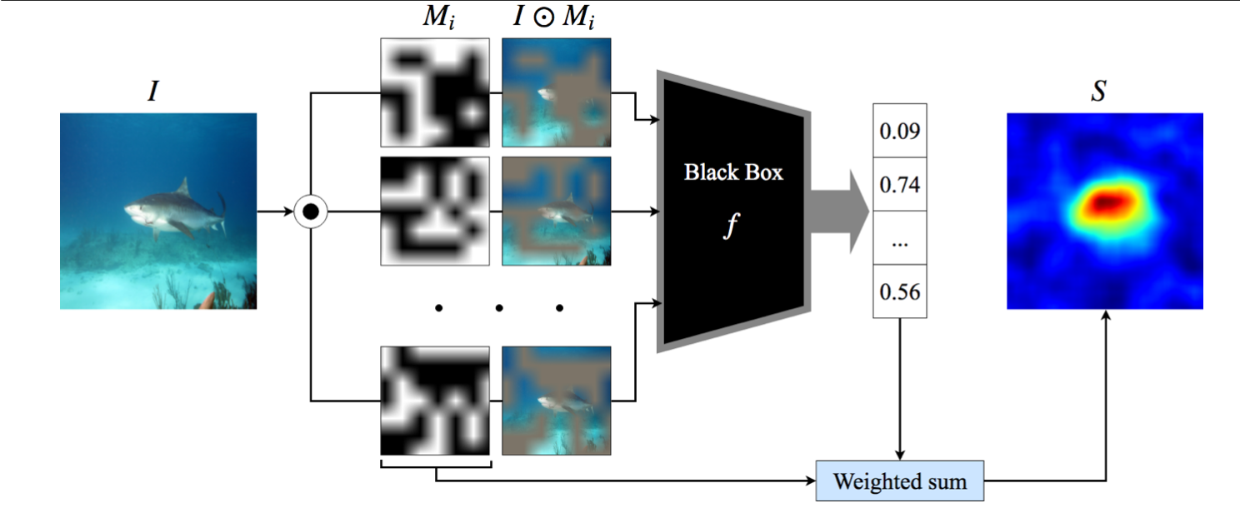
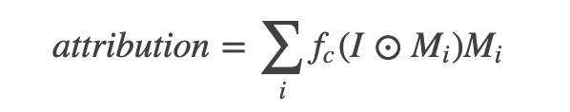
Local Methods for Interpreting CV Models
RISE
A perturbation-based method that generates attribution maps by sampling on multiple random binary masks.

Slide 17
Implementation and Evaluation
03

Slide 18
MindSpore Explainer
mindspore.explainer.explanation
Gradient
Deconvolution
GuidedBackprop
GradCAM
Occlusion
RISE
https://www.mindspore.cn/doc/api_python/en/r1.1/mindspore/mindspore.explainer.html#module-mindspore.explainer.explanation
Notes:
https://auth.huaweicloud.com/authui/login?id=hwstaff_msc21_tutor

Slide 19
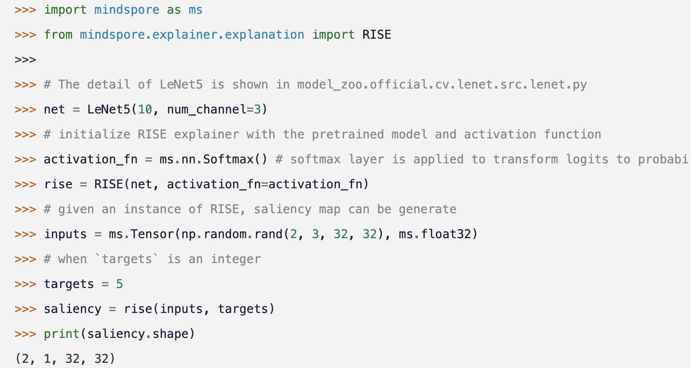
Usage

Slide 20
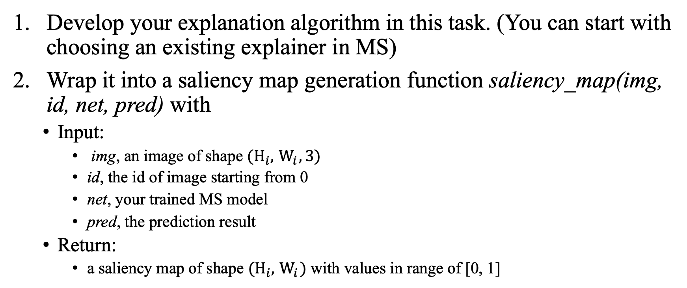
Prepare your own explainer
Develop your explanation algorithm in this task. (You can start with choosing an existing explainer in MS)
Wrap it into a saliency map generation function saliency_map(img, id, net, pred) with
Input:
img, an image of shape $(H_{i},{ W}_{i},3)$
id, the id of image starting from 0
net, your trained MS model
pred, the prediction result
Return:
a saliency map of shape $(H_{i},{ W}_{i})$ with values in range of [0, 1]
https://mindsporechallenge21.github.io/MSC21_Documentation/rules/rules/submission-detail.html

Slide 21
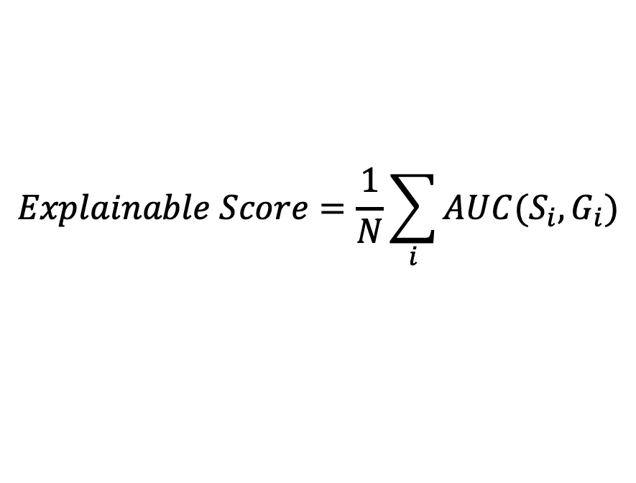
Evaluation Criteria
Each image will only contain a single type of cancerous cells along with normal cells in the explaination evaluation set.
Explainable score is measured by mean AUC of the generated saliency maps {S_{i}}, against the ground truth binary masks {G_{i}} that depict the cancerous regions annotated by experts.
$$Explainable Score=\frac{1}{N}\sum_{i}{AUC(S_{i}, G_{i})}$$
https://mindsporechallenge21.github.io/MSC21_Documentation/rules/rules/submission-detail.html

Slide 22
Thanks

